Slide 1
Principal’s Report
GO Team Meeting #1

Slide 2
TOPICS
School Start Update
Current Enrollment & Leveling
School Strategic Plan
Strategic Plan Overview
SMART Goals
GMAS Results

Slide 3
School start UPDATE

Slide 4
General Information about Start of School
Notes:
Principals – please provide a general update as to how the school year is going

Slide 5
Enrollment
Projected Enrollment | 1480
Current Enrollment | 1519
Difference | 39
Leveling
Leveling is the process the District uses to adjust school budget allocations to match student enrollment.
Budget Impact | $377,739
Notes:
Principals: Based on your enrollment, please give your GO Team the information on how you plan to account for any budget changes due to leveling.

Slide 6
2021-2025 Strategic Plan

Slide 7
Notes:
Link to actual plan: file:///C:/Users/afielder/Downloads/Sutton%202022.2025%20Strategic%20Plan%20Working%202.8.pdf

Slide 8
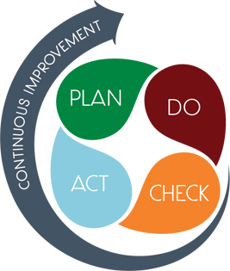
Strategic Plan Smart Goals
Overview
Priorities
Key Aspects
SMART GOALS

Slide 9
Georgia Milestones Assessment Results

Slide 10
GMAS Results

Slide 11
GMAS Results

Slide 12
GMAS Results

Slide 13
GMAS Results

Slide 14
GMAS Results

Slide 15
GMAS Results

Slide 16
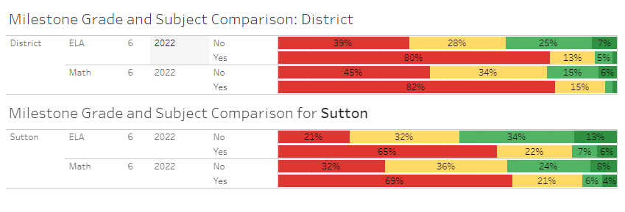
GMAS Results SWD

Slide 17
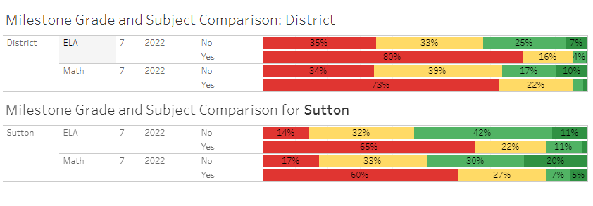
GMAS Results SWD

Slide 18
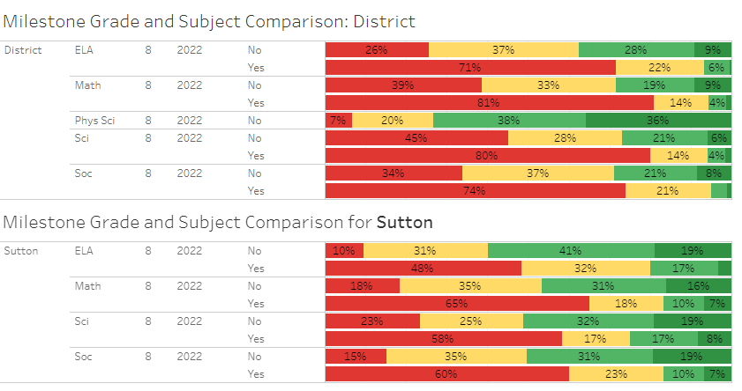
GMAS Results SWD

Slide 19
Glows & Grows
Glows
Grows
6th grade: 43% proficient & above (ELA)
29% proficient & above (Math)
District: 30% proficient & above (ELA)
18% proficient & above (Math)
7th grade: 49% proficient & above (ELA)
45% proficient & above (Math)
District: 28% proficient & above (ELA)
23% proficient & above (Math)
8th grade: 55% proficient & above (ELA)
43% proficient & above (Math)
48% proficient & above (Sci)
47% proficient & above (Soc)
District: 33% proficient & above (ELA)
25% proficient & above (Math)
24% proficient & above (Sci)
25% proficient & above (Soc)
Sub-group performance
-Decrease students in beginning and developing for all sub-groups
-Increase students in proficient and distinguished for all sub-groups
-Focus on targeted instruction & goal setting/reflection to support students
Next Steps:
Data Summits
Personalized Learning
Targeted Instruction
Goal Setting/Reflection
Targeted PL
Collaborative Planning

Slide 20
Questions?

